Slide 1

Airbnb Hotel Booking Analysis
Raghavendra Rao Kulkarni
INTERNSHIP_17546440516895be537820f
APPLY_175647250568b1a4b99b32a

Slide 2

PROBLEM STATEMENT
Airbnb serves as a global marketplace connecting travelers with hosts who offer short-term stays in their homes or apartments. A major challenge for hosts lies in setting an appropriate price for their listings. Pricing often fluctuates based on multiple factors, including property size, number of bedrooms and bathrooms, cleanliness standards, accuracy of the listing details, and the quality of communication between hosts and guests.

Slide 3
This project aims to develop a machine learning model capable of predicting Airbnb listing prices. Accurate pricing is vital for both hosts and guests — hosts seek to optimize revenue and occupancy, while guests look for reasonable and competitive rates. By leveraging historical Airbnb data, the model applies regression techniques to uncover patterns between property features (like bedroom count, bathroom count, location, and guest reviews) and listing prices. The trained model can then estimate prices for new or potential listings, enabling hosts to make data-driven pricing decisions.
Project Description :

Slide 4

WHO ARE THE END USERS?
Airbnb Hosts: Can use the model to set optimal prices for their properties by analyzing key factors such as amenities, location, and guest feedback.
Travelers: Can assess whether a listing’s price is justified by comparing it with predicted values based on similar property features.
Airbnb Platform Analysts: Can enhance automated pricing tools, ensuring more accurate and transparent recommendations that build user confidence.
Researchers and Students: Can explore how property characteristics, reviews, and other listing factors influence rental pricing in the sharing economy.

Slide 5

Technology Used
Python: Core programming language used for development and implementation.
Pandas & NumPy: Utilized for data cleaning, preprocessing, and numerical computation.
Scikit-learn: Applied for machine learning tasks, including regression model training, testing, and evaluation.
Matplotlib & Seaborn: Used for visualizing data patterns, trends, and feature importance.
Google Colab: Cloud-based environment for executing code and collaborating efficiently.
File Handling Libraries: Includes openpyxl for Excel file operations and Python’s built-in CSV modules for data input/output handling.

Slide 6
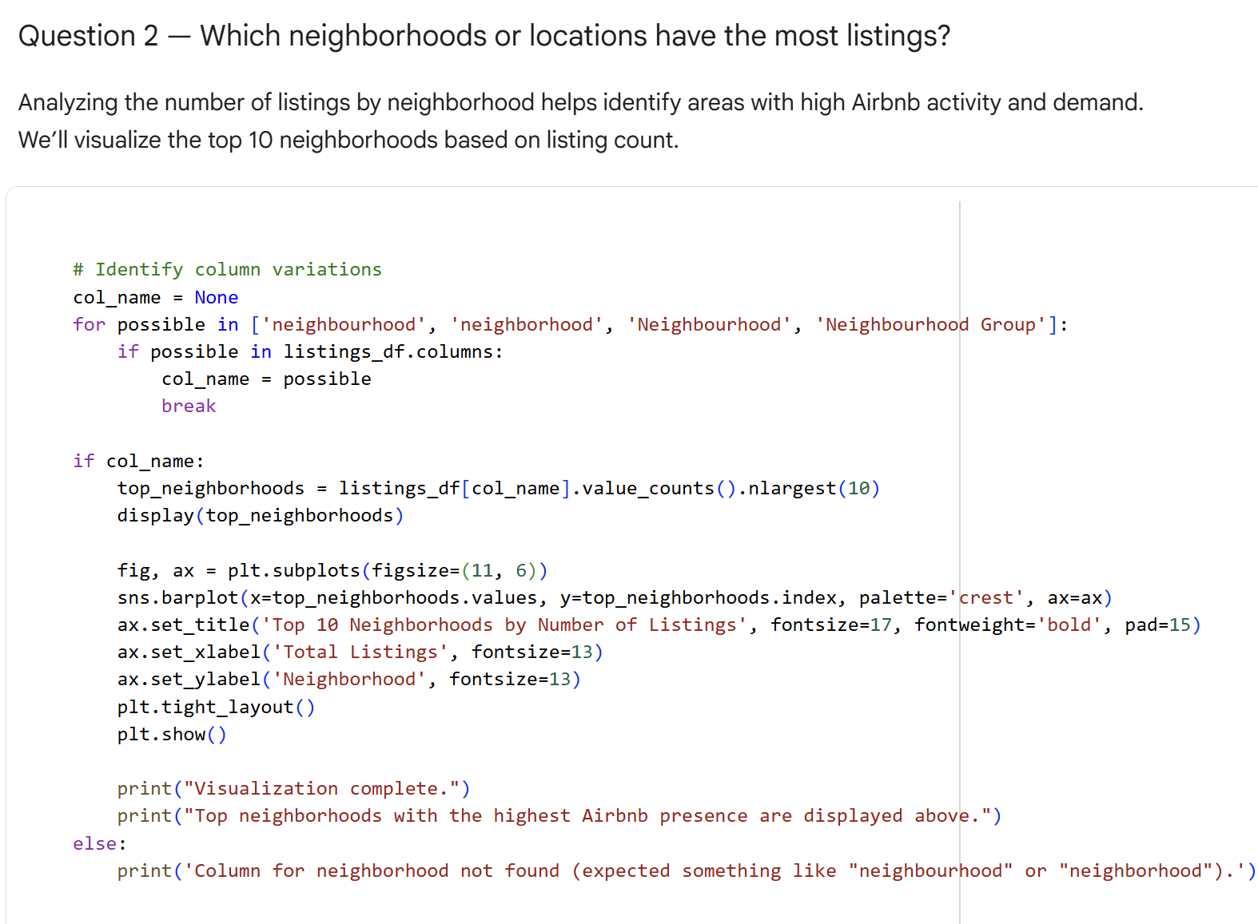
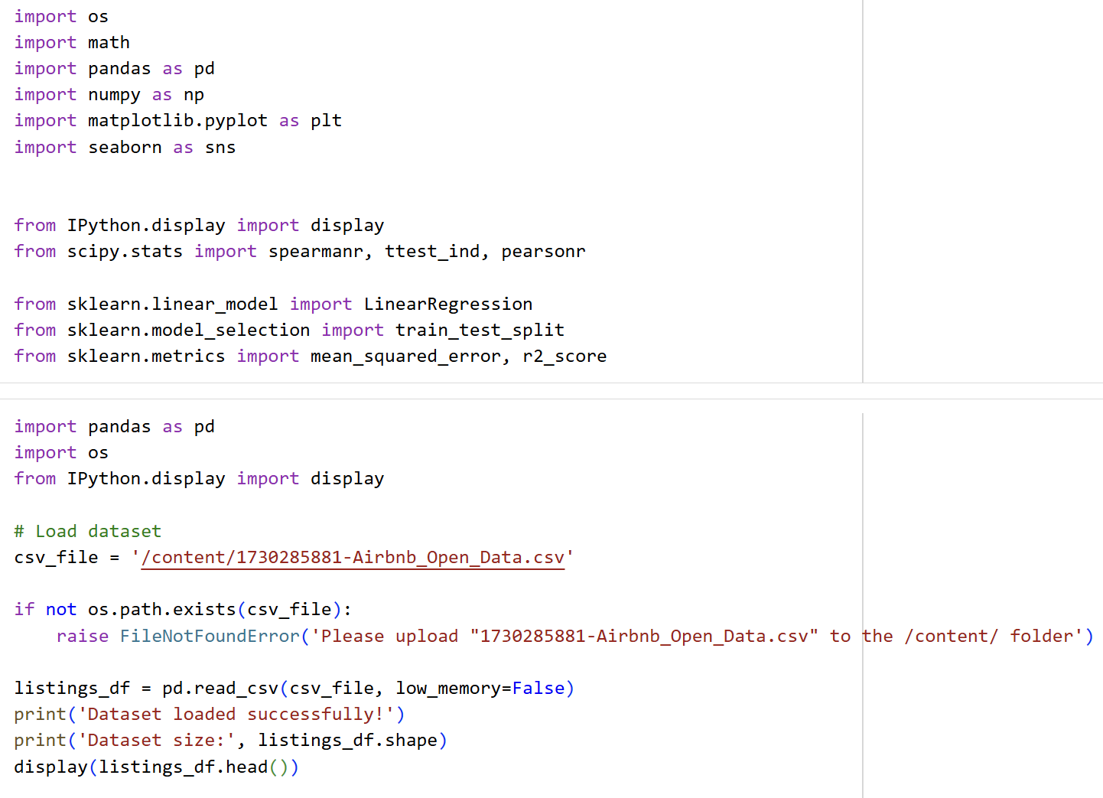
RESULTS1
Demo Link

Slide 7
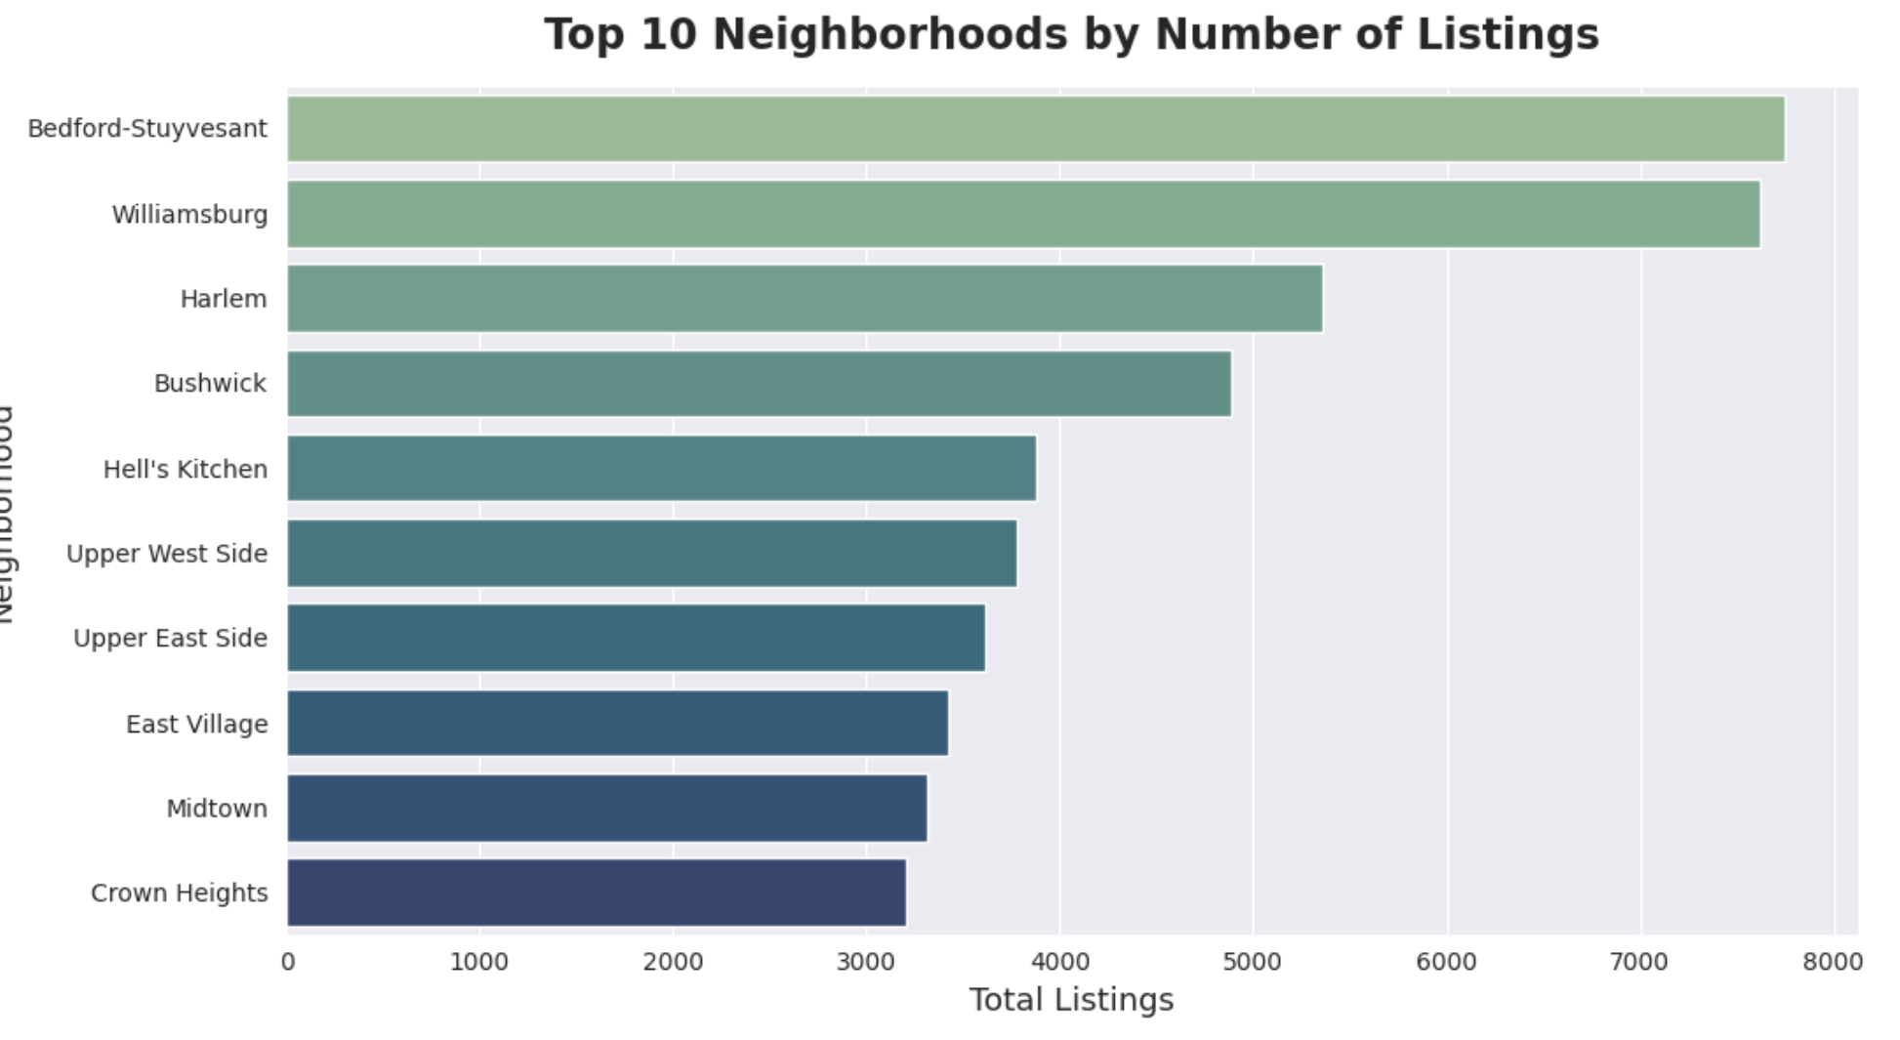
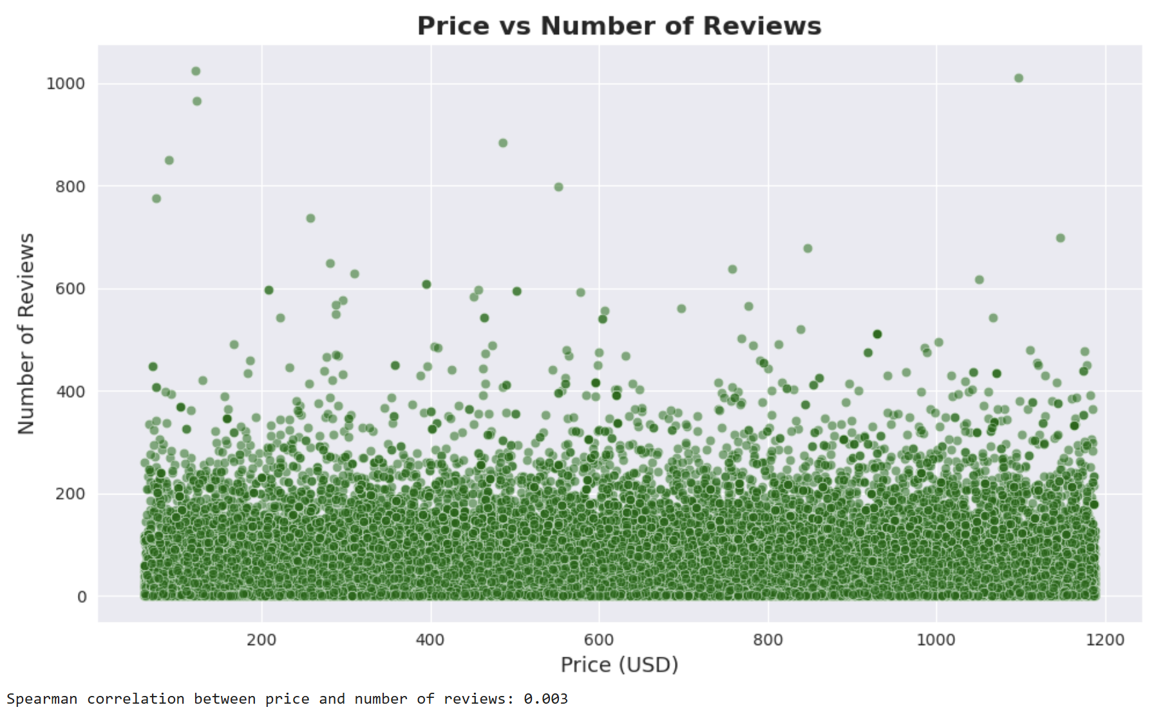
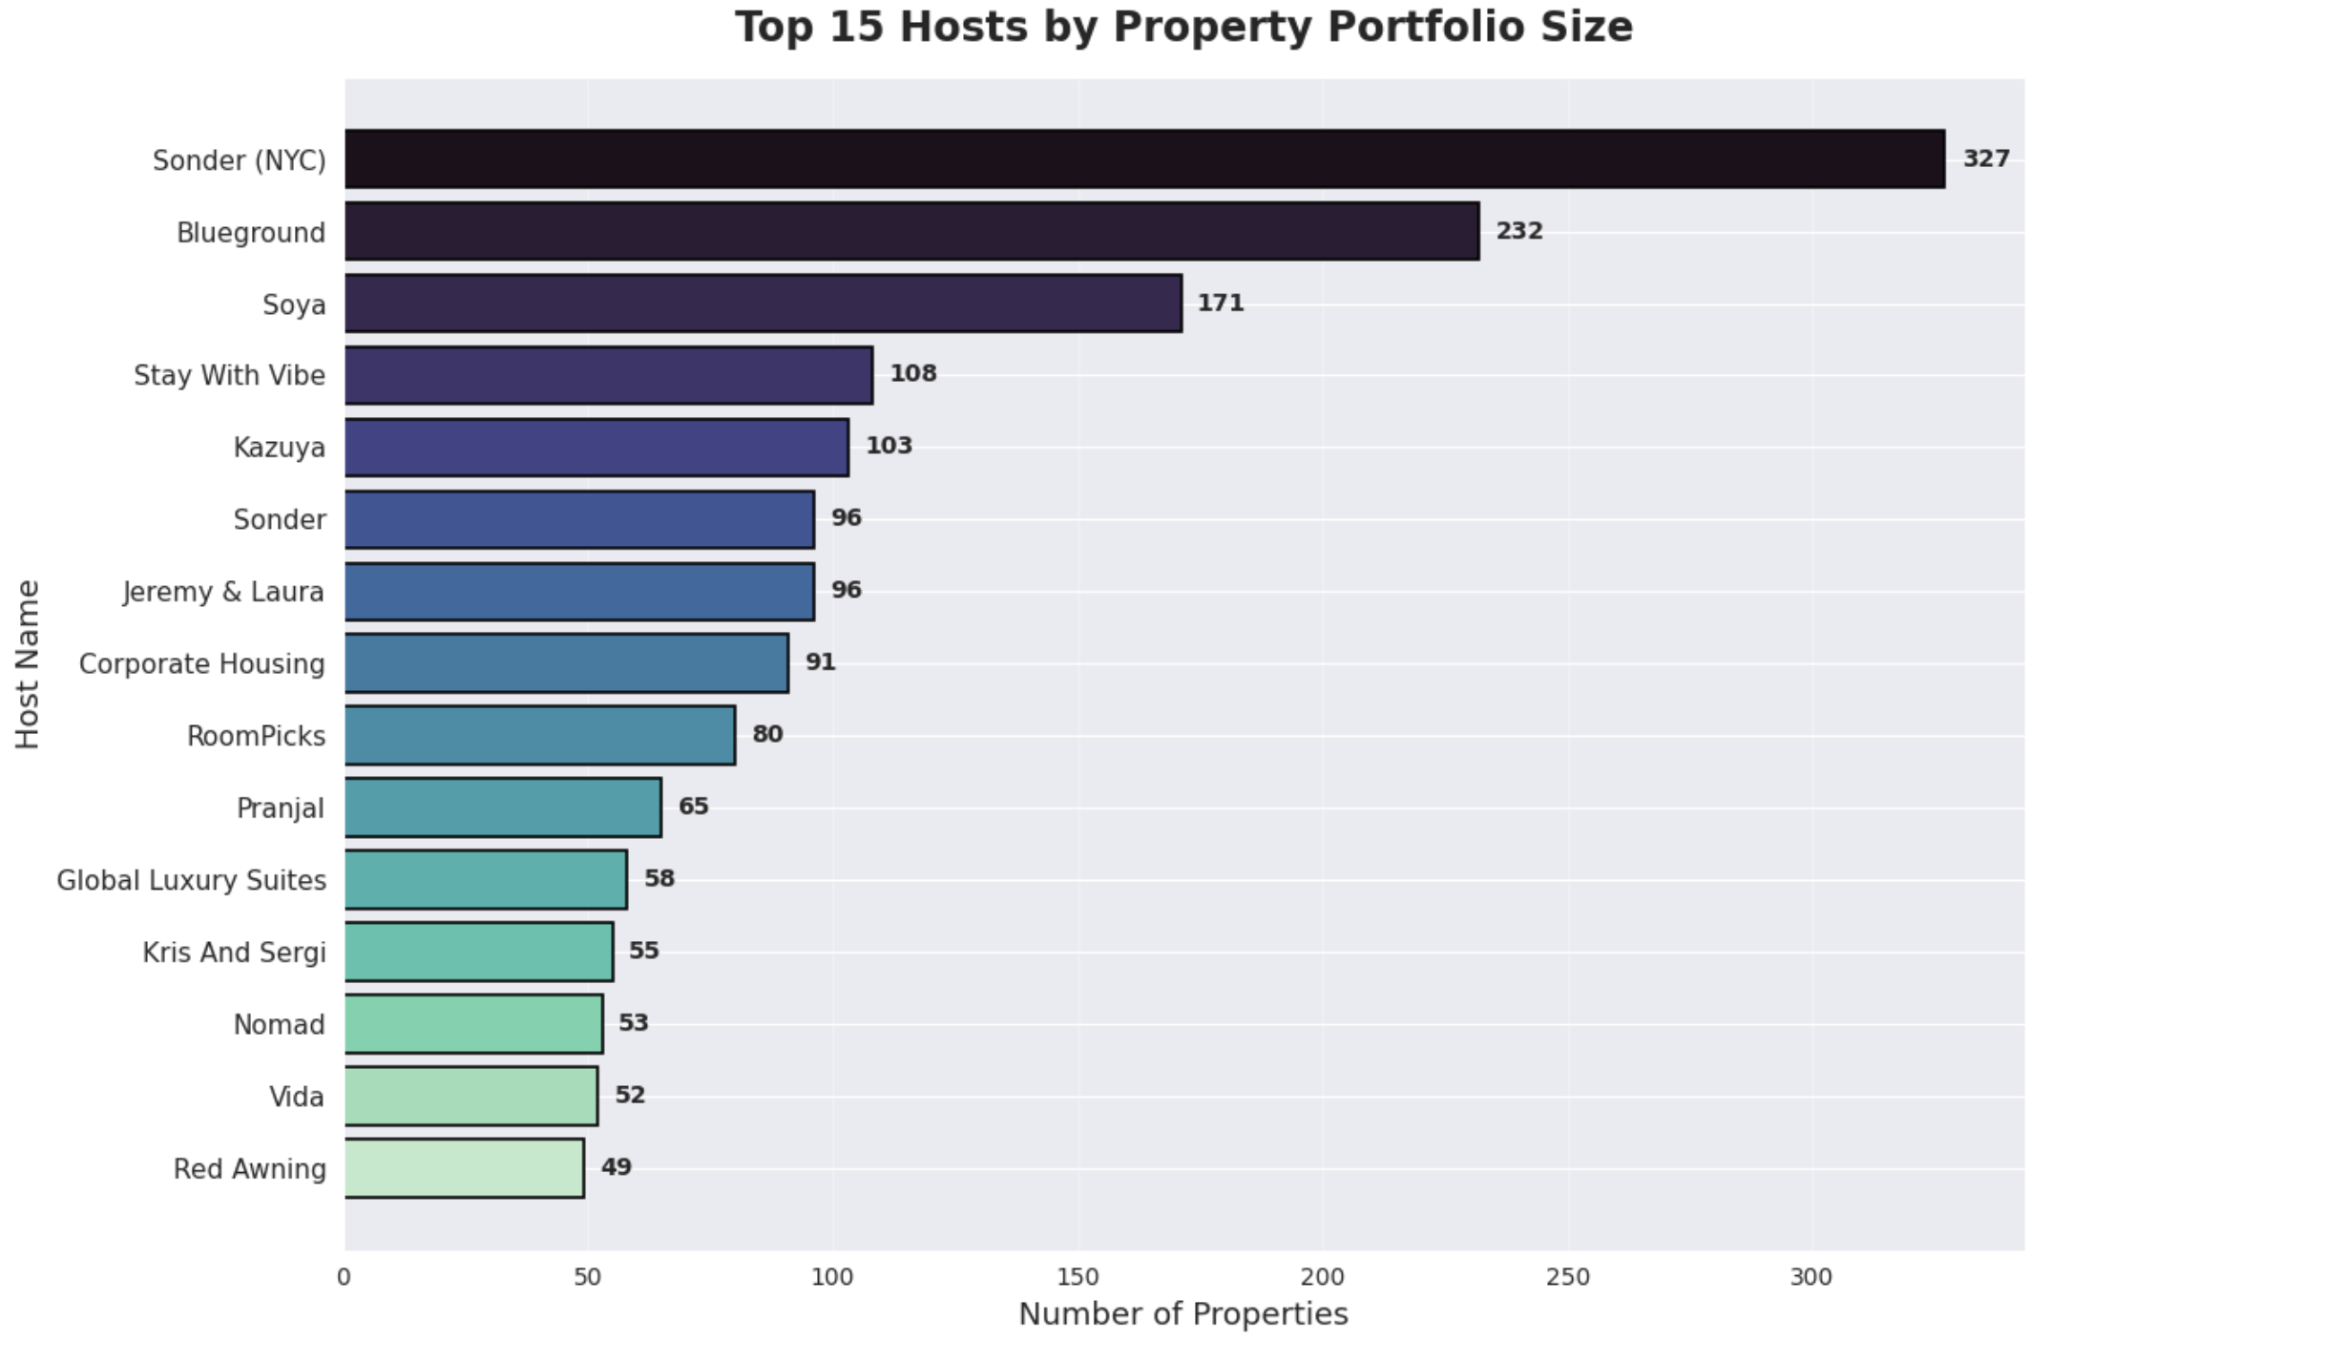
RESULTS2
Demo Link

Slide 8
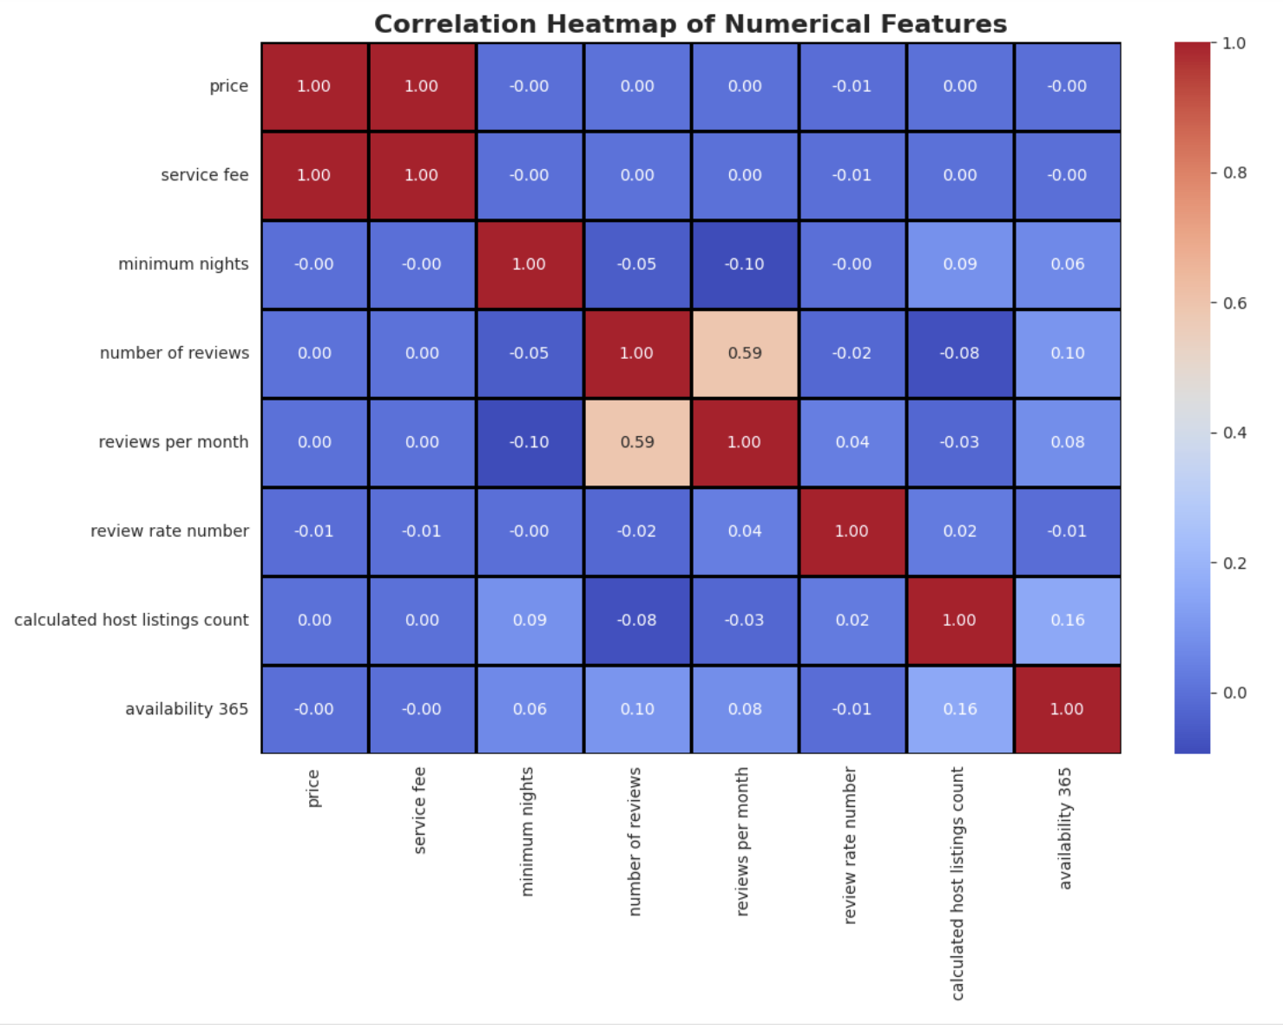
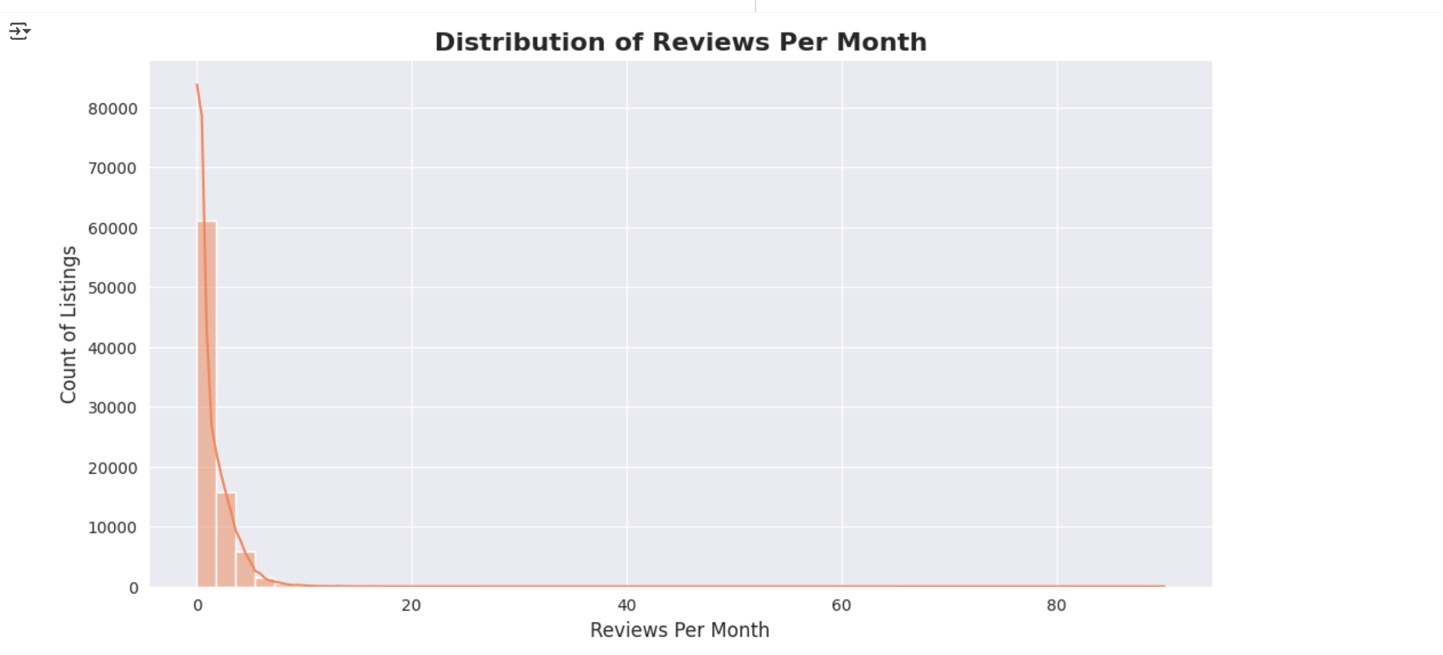
RESULTS3
[Add screen shots of your code or Chart(s) ]
Demo Link

Slide 9
GitHub repository
https://github.com/AlgorythmRK/VOIS_AICTE_Oct2025_Raghavendra_Rao_Kulkarni
Demo Link

Slide 10
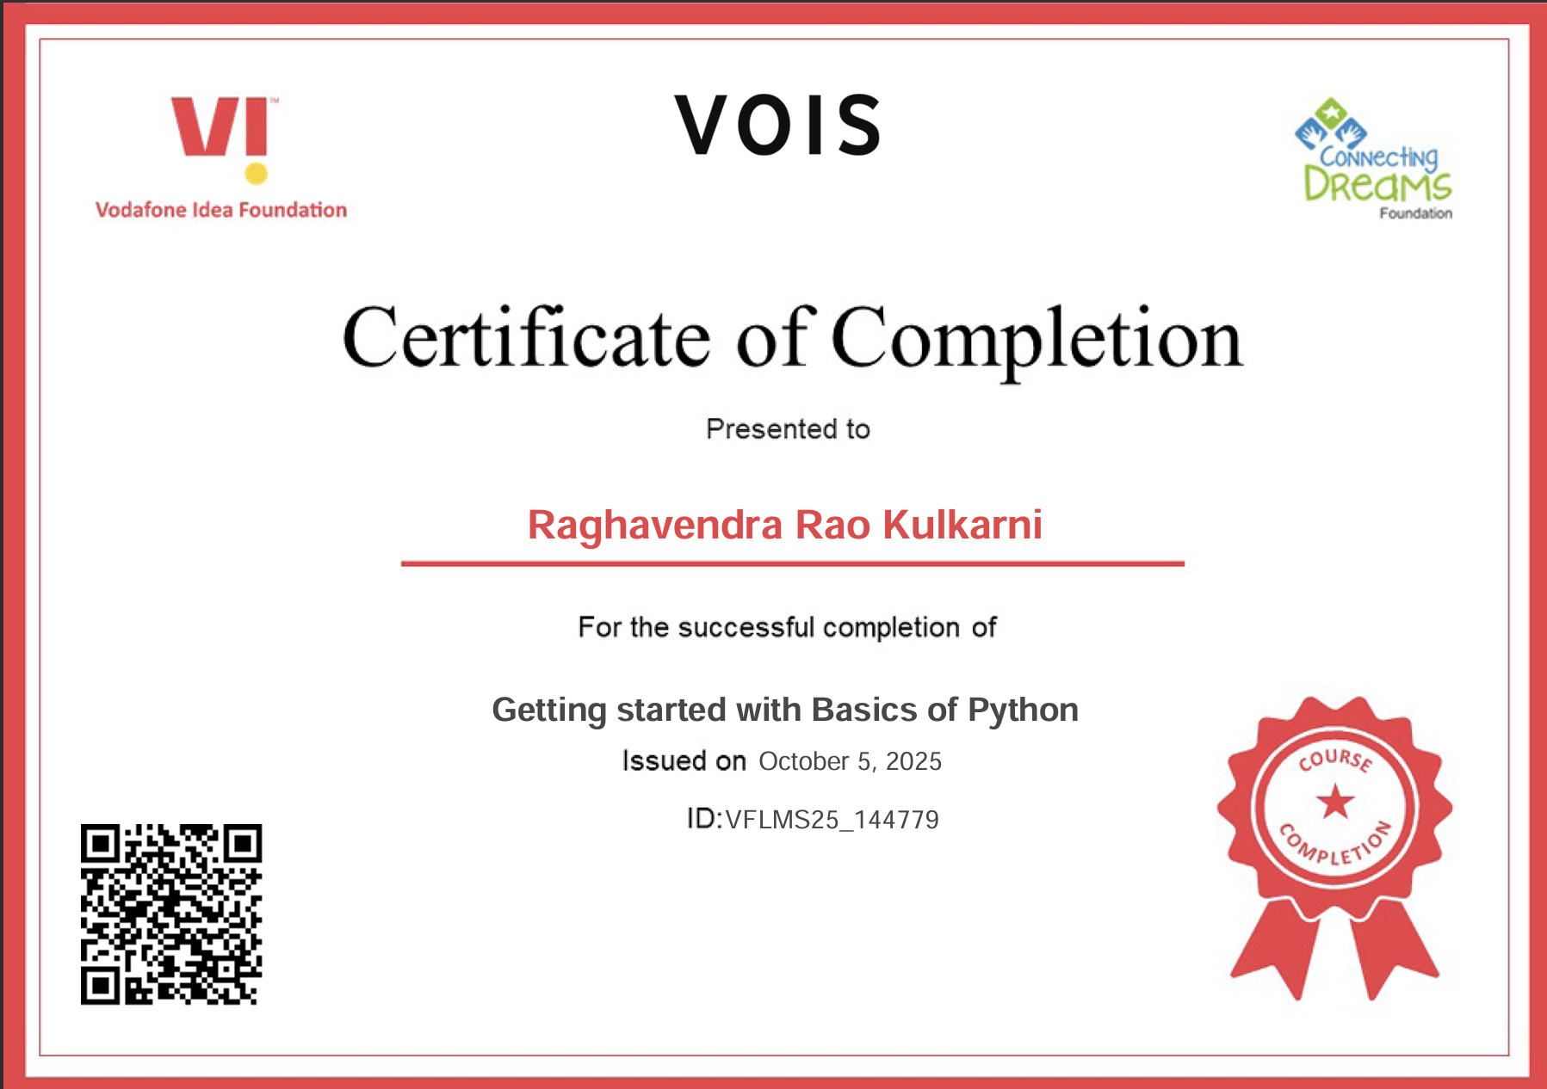
Getting started with Basics of Python Certificate

Slide 11
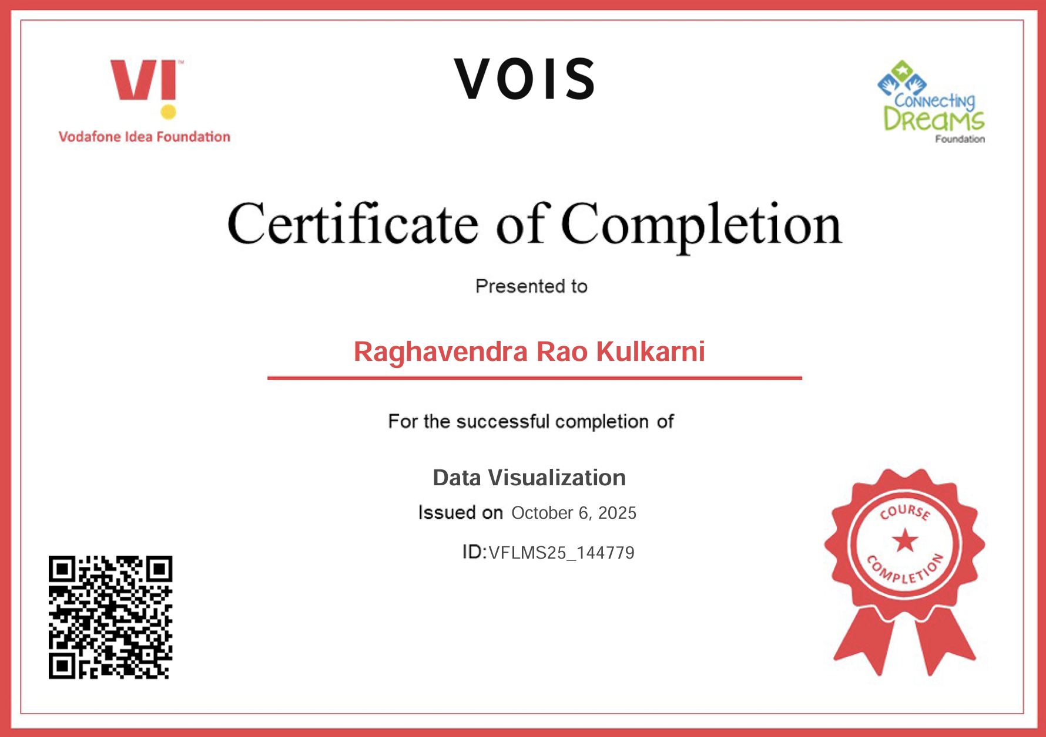
Data Visualization Certificate
[Paste your Certificate Here]

Slide 12
Thank you
.
.

